Slide 1



Fake News Detection & Verification Tool
Shuvom Dhar
Year 2026
Sister Nivedita University
Department of Computer Science & Engineering

Slide 2







Intelligent System
Motivation
Develops an intelligent system to detect and verify fake news using machine learning and natural language processing.
Addresses the urgent need for automated detection due to the rapid spread of misinformation on digital platforms.
01
02
Why This Project Matters
Significance
Provides an effective technological solution to improve information credibility and foster a safer online environment.
03

Slide 3


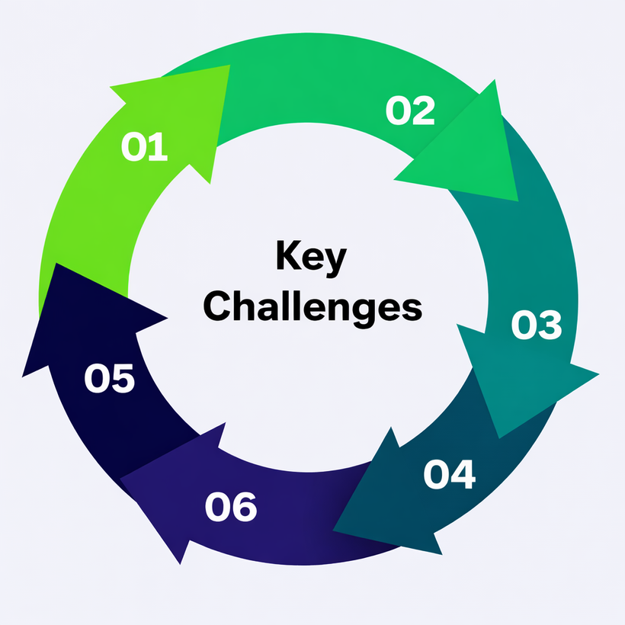




Project Statement
The rapid spread of fake news demands an automated, intelligent system for real-time detection and verification.
01
02
High accuracy with complex language
Handling sarcasm and ambiguity
02
03
04
01
Multilingual misinformation
Limited real-time fact-checking data
Key Challenges
03
06
05
06
05
04
Ensuring AI explainability
Efficient large-scale data processing

Slide 4










Expected Outcomes & Impact
This tool empowers users, journalists, and researchers to verify news authenticity, fostering a more trustworthy digital ecosystem and strengthening media literacy.
Accurate Identification
Improved Performance
Real-time Verification
User-Friendly Interface
Reduced Misinformation
Precise classification of fake and real news using ML and NLP.
High accuracy, precision, recall, and F1-score in classification.
Instant detection and verification of news from multiple sources.
Easy input and visualization of results for all users.
Reliable verification outcomes to curb the spread of fake news.
01
02
03
04
05

Slide 5
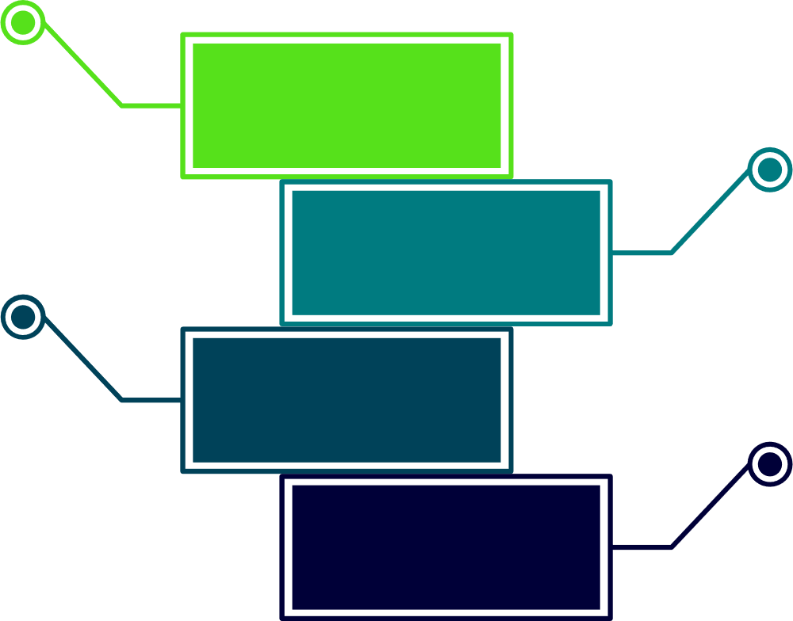





Technology Used
This project integrates modern web technologies, secure authentication, and machine learning for an efficient and scalable fake news detection system.
Backend
Python
Flask
SQLAlchemy
01
Security
JWT Authentication
02
Frontend
HTML
CSS
JavaScript
03
ML & NLP
TF-IDF
Tokenization
Stopword Removal
Lemmatization (spaCy, NLTK)
04

Slide 6


Modules To Be Implemented
Each module plays a critical role in the system's ability to process, analyze, and present news authenticity effectively.
1
Authentication
Manages user registration, login, and secure access.
3
NLP Processing
2
News Input
Preprocesses text for ML models (tokenization, stop-word removal).
Allows users to submit news content (text or URLs).
4
Prediction
5
Database
6
Frontend
Classifies news as real or fake using trained ML models.
Stores user info, news data, and prediction results.
Provides an interactive, user-friendly interface.

Slide 7



Architecture Diagram
NLP Preprocessing
Fake News Classifier
Dashboard
Input Module
User
Result Display
News Text /
URL
Tokenization, Stopword Removal, Lemmatization
Transformer-based Models
RoBERTa / BERT
Source & Claim Info
Suspicious Keywords
Credibility Score
Flask Backend
Claim Verification
SQLAlchemy
JWT Authentication
Google Fact Check Tools
PolitiFact API
Input → NLP → ML Model → Fact Verification → Backend → Dashboard Output

Slide 8

DataBase Schema
The system uses SQLAlchemy as the database ORM (Object-Relational Mapping) tool to manage and interact with the database efficiently. It stores user information, news content, and prediction results, ensuring secure, scalable, and efficient data handling and retrieval.
USERS TABLE
ARTICLES TABLE
PROCESSED TEXT TABLE
ENTITIES TABLE
VERIFICATION RESULTS TABLE

Slide 9






Feature Enhancement
Future enhancements aim to improve accuracy, accessibility, scalability, and real-time verification.
01
02
03
04
05
Integration with social media platforms
Deep learning-based detection
Multilingual support
Mobile application development
Scalable and Secure Design
Real-time monitoring of news posts on platforms like Google and Facebook.
Using advanced neural networks (e.g., BERT, LSTM) for higher prediction accuracy.
Extending detection capabilities to multiple languages beyond English.
Making the tool accessible on mobile devices for better reach and convenience.
Scalable and secure system design

Slide 10




Conclusion
The Fake News Detection and Verification Tool successfully integrates NLP, machine learning, and web technologies to provide an automated and reliable way to identify misinformation.
01
01
It demonstrates accurate classification of fake and real news.
02
02
The system ensures secure user authentication.
03
The project provides a scalable, user-friendly, and explainable solution for real-world fake news detection.
03
The tool improves digital trust by allowing users to quickly verify the authenticity of news content in an automated and efficient manner.

Slide 11
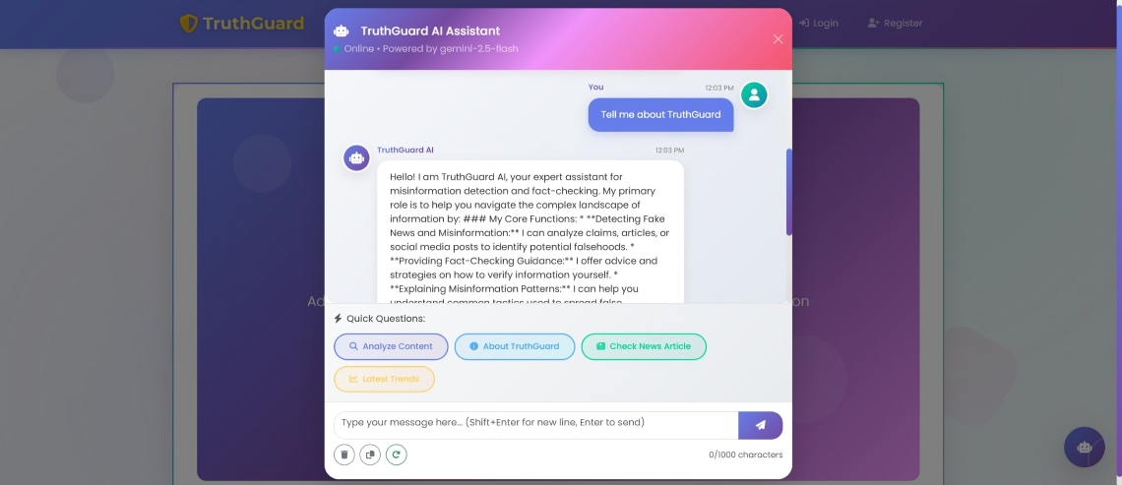
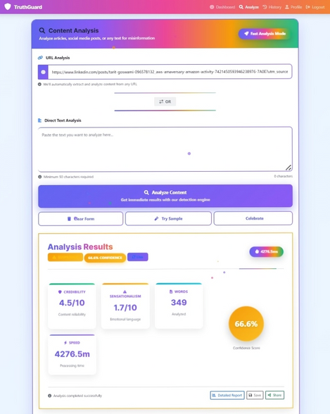
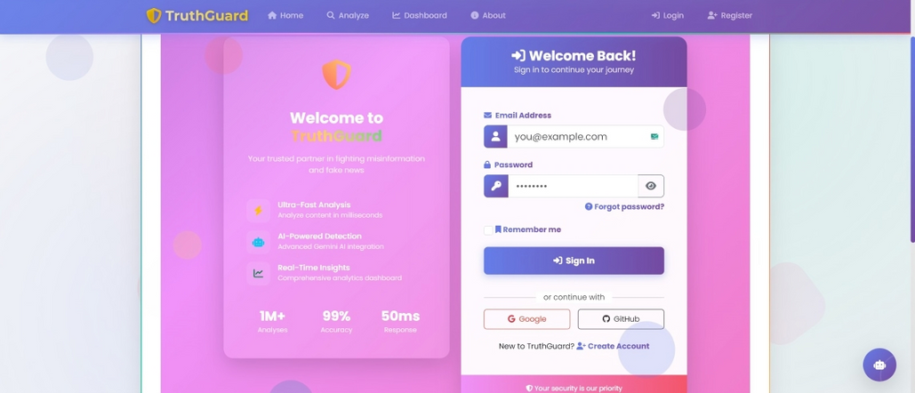
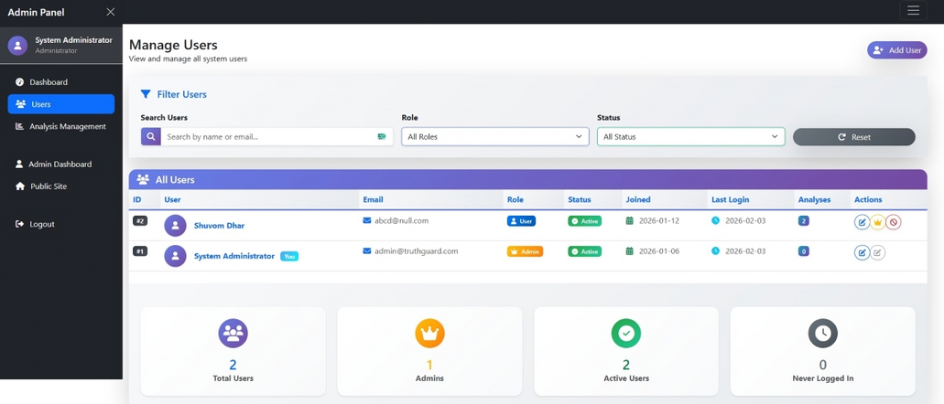
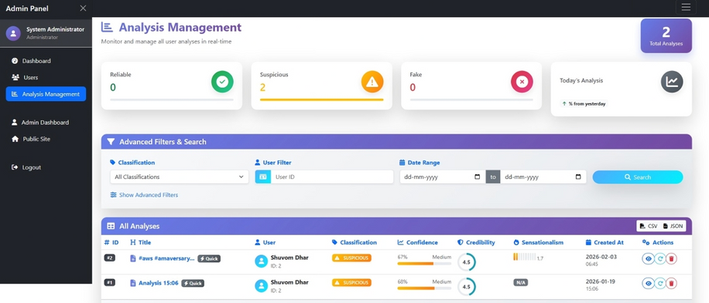
Sample Output
03
02
01
04
05

